Slide 1

Implementation of Clustering Algorithms in C to offer Business Insights
Submitted by
SUYASH SHARMA (Enroll No. 18021140099 )
KASHIF AHAMAD (Enroll. No. 19021180103)
VARUNDEEP SINGH (Enroll. No. 18021140089 )
Under the guidance of
Dr. Manoj Kumar, Assistant Professor

Slide 2
Abstract
The project aims to implement clustering algorithms in C to offer business insights.
Clustering is the process of organizing objects into groups whose members are similar in some way. It aims to segregate groups with similar traits and assign them into clusters.
Clustering helps businesses to manage their data better – For example customer segmentation, market segmentation and information retrieval.. For retail businesses, data clustering helps with customer shopping behavior, sales campaigns and customer retention.

Slide 3
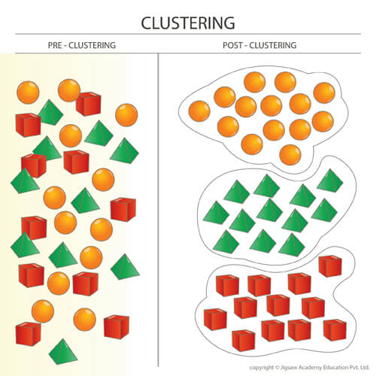
Introduction: Clustering
Clustering is an unsupervised machine learning approach, that involves the grouping of data points. Given a set of data points, we can use a clustering algorithm to classify each data point into a specific group.
Different types of methods of Clustering used:
Centroid Based Clustering K-means Clustering
Connectivity Based Clustering Hierarchical Clustering
Density Based Clustering DBSCAN (Density Based Spatial Clustering of Applications with Noise)

Slide 4
Problem Statement
One of the biggest problems with marketing is customer segmentation.
Customer Segmentation is forming clusters of customers on the basis of their behaviour.
Businesses develop huge amount of sales data and are clueless as to what to do with it.
Businesses need to organize the huge amounts of available data into meaningful structures or break a large heterogeneous population into smaller homogeneous groups.

Slide 5
Literature Review
Cluster analysis partitions points of a data set into groups, so that data points within a group are more similar to each other than to points in different groups. [1]
This technique subdivides a group into subdivisions, which consists of three steps: obtaining of agreement scores of each individual; division of the group on the basis of these agreement scores; determination of pattern that produces the agreements. [2]
The k-means algorithm is efficient in clustering large data sets. However, working only on numeric values prohibits it from being used to cluster real world data containing categorical values. [3]
Identification of clusters is the most widely studied problem in this area. [4]
On evaluating the results of cluster analysis, we need to make use of a number of fixed heuristics rather than to compare a data clustering directly against an empirically derived standard. [5]

Slide 6
Objective
Our main objective of this project is to form meaningful clusters from the set of data point given to the algorithms, which would later be reviewed or analyses to offer business insights.
The software should be able to perform on demo data sets given to it as well as new data sets provided at any instance of time.
Once clusters are segregated, tests can be run on each group with different cases that will help businesses better target their marketing goals.

Slide 7
Methodology
Steps:
Acquisition of sales and products data set in desired format.
Preprocessing of the document is done. Entries with missing values could either be dropped or filled with a method like average value of the field or most frequent value.
Data points will be clustered using three different algorithms.
These clusters will allow to perform customer segmentation, on the basis of which marketing strategies could be developed.
Testing would be done by making use cases for each module and each of these algorithms.
Octave is used to show a demo of this algorithm being run on a large data set, also used in initial prototyping and testing.

Slide 8
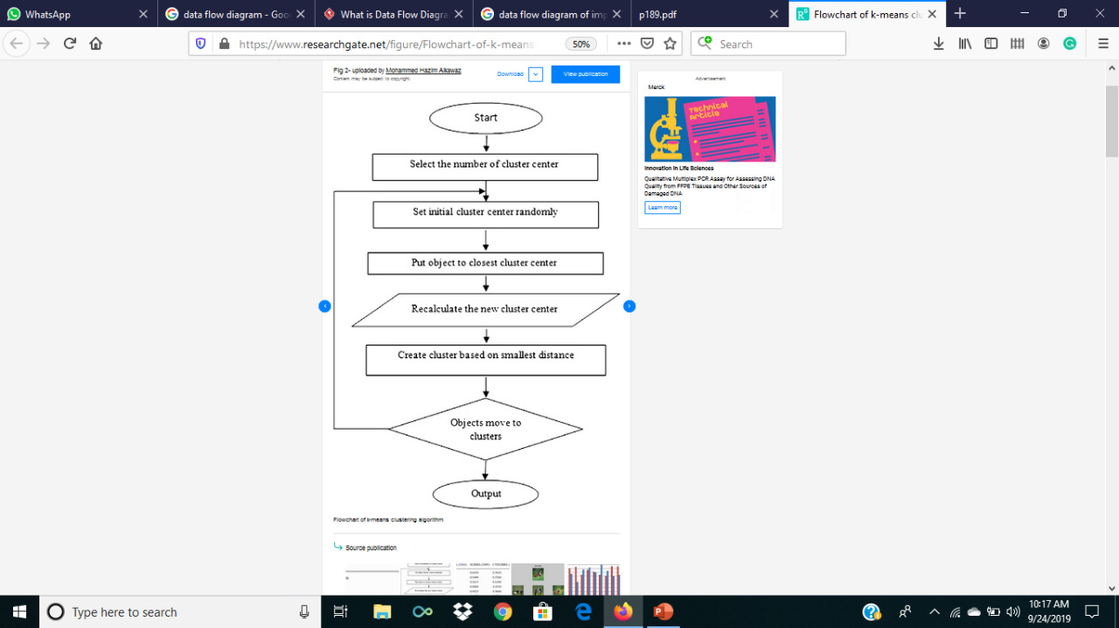
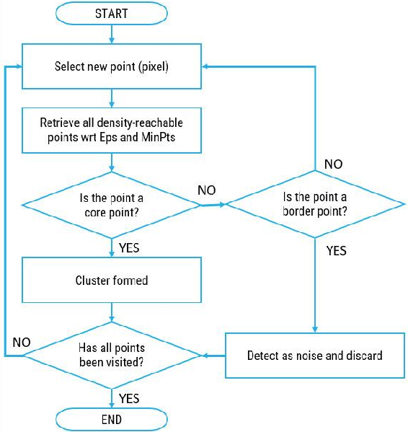
Algorithm(Flowchart)
Flowchart of kmeans algorithm
Flowchart of DBSCAN

Slide 9
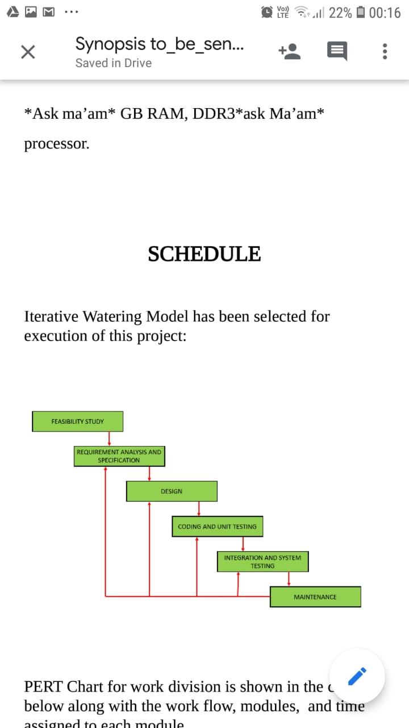
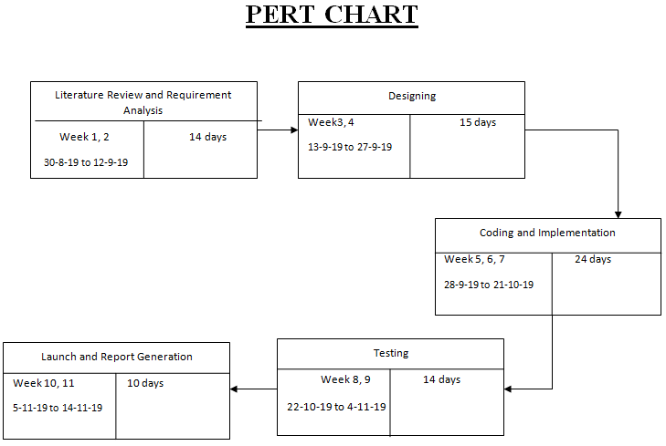
Schedule
Iterative Waterfall Model has been selected for the execution of this project.
PERT Chart for work division is shown in the chart below along with the work flow, modules, and time assigned to each module.

Slide 10
References
[1] Auffarth, B. (July 18–23, 2010). "Clustering by a Genetic Algorithm with Biased Mutation Operator". Wcci Cec. IEEE.
[2] Zubin, Joseph (1938). "A technique for measuring like-mindedness". The Journal of Abnormal and Social Psychology. 33 (4) doi:10.1037/h0055441. ISSN 0096-851X.
[3] Huang, Z. (1998). "Extensions to the k-means algorithm for clustering large data sets with categorical values". Data Mining and Knowledge Discovery. 2 (3) doi:10.1023/A:1009769707641.
[4] Tian Zhang, Raghu Ramakrishnan, Miron Livny. "An Efficient Data Clustering Method for Very Large Databases." In: Proc. Int'l Conf. on Management of Data, ACM SIGMOD
[5] Pfitzner, Darius; Leibbrandt, Richard; Powers, David (2009). "Characterization and evaluation of similarity measures for pairs of clusterings". Knowledge and Information Systems. Springer. 19 (3): doi:10.1007/s10115-008-0150-6.

